Slide 1
Architecture
(DBMS)
Notes:
‹#›

Slide 2
DBMS Interfaces
Menu-based Interfaces for Web Clients or Browsing
Forms-Based Interfaces
Graphical User Interface
Natural Language Interfaces
Speech input and Output
Interfaces for Parametric Users.
Interfaces for the DBA

Slide 3
Centralized and Client Server Architecture
Centralized DBMSs Architecture
Basic Client/ Server Architecture
Two-Tier Client/ Server Architectures
Three-Tier and n-Tier Architecture

Slide 4
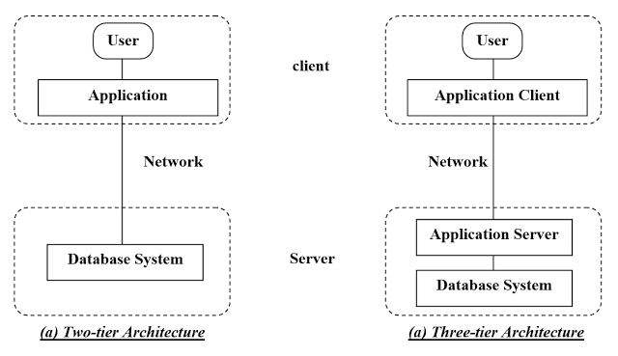
Two- tier and three tier architecture

Slide 5
Relational Database: Definitions
Relational database: a set of relations
(relation = table)
A Relation is a mathematical concept based on the ideas of sets
The model was first proposed by Dr. E.F. Codd of IBM Research in 1970 in the following paper:
"A Relational Model for Large Shared Data Banks," Communications of the ACM, June 1970
The above paper caused a major revolution in the field of database management and earned Dr. Codd the coveted ACM Turing Award

Slide 6
Relational Database: Definitions
Relation: made up of 2 parts:
Schema : specifies name of relation, plus name and type of each column.
Instance : a table, with rows and columns.
#rows = cardinality
#fields = degree / arity
Relation: a set of rows or tuples.
all rows are distinct
no order among rows (why?)

Slide 7
Domain: Definitions
A domain has a logical definition:
Example: “USA_phone_numbers” are the set of 10 digit phone numbers valid in the U.S.
A domain also has a data-type or a format defined for it.
The USA_phone_numbers may have a format: (ddd)ddd-dddd where each d is a decimal digit.
Dates have various formats such as year, month, date formatted as yyyy-mm-dd, or as dd mm,yyyy etc.

Slide 8
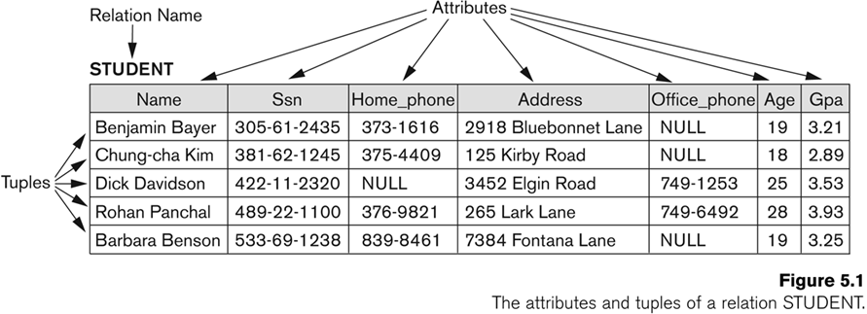
Example of a Relation
Cardinality = 5, arity = 7 ,
all rows distinct
Q: do values in a column need to be distinct?

Slide 9
Summay
Formally,
Given R(A1, A2, .........., An)
n r(R)⊂dom (A1) X dom (A2) X ....X dom(An)
R(A1, A2, …, An) is the schema of the relation
R is the name of the relation
A1, A2, …, An are the attributes of the relation
r(R): a specific state (or "value" or “population”) of relation R – this is a set of tuples (rows)
r(R) = {t1, t2, …, tn} where each ti is an n-tuple
ti = <v1, v2, …, vn> where each vj element-of dom(Aj)

Slide 10
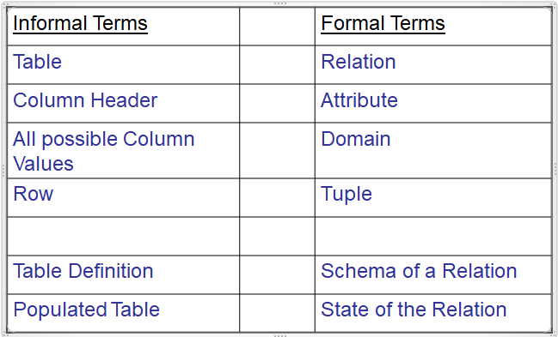
Summay

Slide 11
What are Keys?
Keys are the essential elements of any relational database.
It identifies each tuple in a relational uniquely.
Keys are one form of integrity constraint (IC)
Keys are also used used to establish the relationship among the tables in a relational database.

Slide 12
DBMS keys
DBMS has five types of keys in it and they has different functionality.
The keys are as follows:
Candidate Key
Super Key
Primary Key
Foreign Key
Composite Key
Let’s discuss one by one all of the five keys

Slide 13
Candidate Key
Minimum number of attributes used to differentiate records of the relation
Example:
Sid:key
Sid, Snake:not key
Sid | Sname | Branch
S1 | A | CS
S2 | B | CS
S3 | C | EC

Slide 14
Primary Key
One of the Candidate Key
No two records are same values(unique)
No null value
DBA assigns one of the key as primary key
Example : Sid:primary key
Sid | Sname | Branch
S1 | A | CS
S2 | B | CS
S3 | C | EC

Slide 15
Alternative key/Secondary key
All candidate key except primary key
No two records with same values
Null are possible
More than one possible.
Example: Pno, Lno
Sid | Sname | Pno | Lno | DoB | fname
S1 | A | Null | L3 | 10/10 | X
S2 | A | Null | L1 | 10/12 | Y
S3 | B | P4 | L2 | 11/12 | Y
S4 | C | PL | L10 | Null | Z

Slide 16
Null value
Unknown and un existed values
Not equal to zero
Not equal to empty string
No two null value are same
Set of ascii character assigned by DBMS
Sid | Sname | Pno | Lno | DoB | fname
S1 | A | Null | L3 | 10/10 | X
S2 | A | Null | L1 | 10/12 | Y
S3 | B | P4 | L2 | 11/12 | Y
S4 | C | PL | L10 | Null | Z

Slide 17
Super Key
Number of attributes required to differentiate the records of the relation
No keyword for this key
Minimal superkey is candidate key
Every candidate key is also superkey

Slide 18
Problems
Q. R is a relational schema with R(A1, A2, …,An).
i) How many superkeays are possible with only candidate key A1.

Slide 19
Problems
Q. R is a relational schema with R(A1, A2, …,An).
ii) How many superkeays are possible with candidate keys A1 and A2

Slide 20
Problems
Q. R is a relational schema with R(A1, A2, …,An).
iii) How many superkeays are possible with candidate keys {A1A2 and A3A4}

Slide 21
Problems
Q. R is a relational schema with R(A1, A2, …,An).
iii) How many superkeays are possible with candidate keys {A1A2 and A2A3}

Slide 22
Problems
Q. R is a relational schema with R(A1, A2, …,An).
iii) How many superkeays are possible with candidate keys {A1, A2, A3}

Slide 23
Problems
Q. R is a relational schema with R(A,B,C,D,E).
iii) How many superkeays are possible with candidate keys {A, BC}

Slide 24
Foreign Key (Referecing Key)
Enrolled
Student
Sid | Cid | Fee
S1 | C1 | -
S1 | C2 | -
S2 | C1 | -
S3 | S2 | -
Sid | Sname | Login
S1 | A | @
S2 | A | @
S3 | B | @
S4 | C | @
S5 | B | @

Slide 25
Foreign Key (Referecing Key)
Foreign key is the set of attributes used to reference primary key or alternative key of the same table or some other table.
Possible cases:

